Slide 1
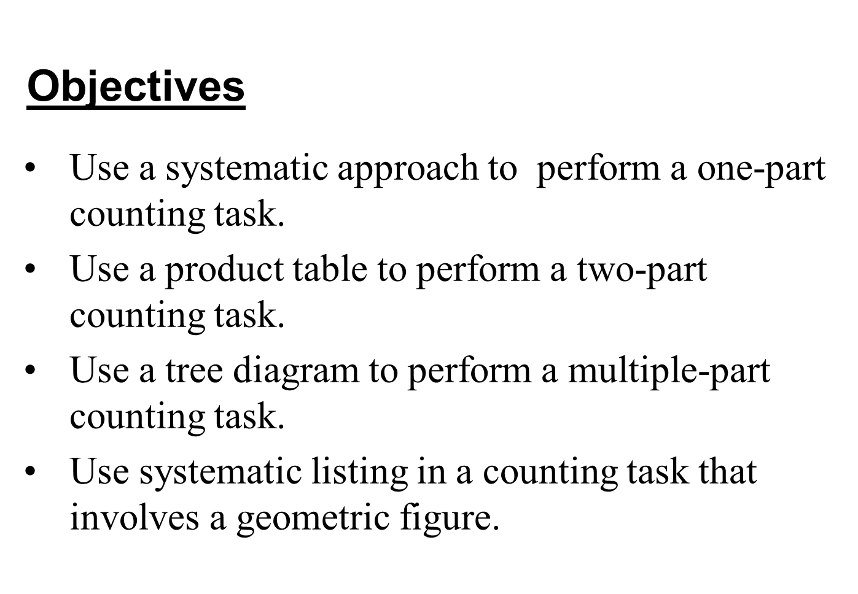
Section 10-1
Counting by Systematic Listing

Slide 2
One-Part Tasks
The results for simple, one-part tasks can often be listed easily.
For the task of tossing a fair coin, the list is heads, tails, with two possible results.
For the task of rolling a single fair die the list is 1, 2, 3, 4, 5, 6, with six possibilities.

Slide 3
Example: Selecting a Club President
Consider a club N with four members:
N = {Mike, Adam, Ted, Helen} or in abbreviated form N = {M, A, T, H}
In how many ways can this group select a president?
Solution
The task is to select one of the four members as president. There are four possible results: M, A, T, and H.
For a similar example on video, see Ex. 1 (0:30 – 1:06) at
http://mediaplayer.pearsoncmg.com/assets/_embed.true/MMI13_sl_10_01
In MyMathLab, go to MultiMedia library, Chapter 10, Section 10.1, Section Video Lectures

Slide 4
Example: Building Numbers from a Set of Digits
Determine the number of two-digit numbers that can be written using the digits from the set {2, 4, 6}.
Solution
The task consists of two parts.
1. Choose a first digit.
2. Choose a second digit.
The results for a two-part task can be pictured in a product table, as shown on the next slide.
For a similar example on video, see Ex. 2 (1:08 – 2:07) at
http://mediaplayer.pearsoncmg.com/assets/_embed.true/MMI13_sl_10_01
In MyMathLab, go to MultiMedia library, Chapter 10, Section 10.1, Section Video Lectures

Slide 5
Example: Building Numbers from a Set of Digits
Solution (continued)
 |  | Second Digit
 |  | 2 | 4 | 6
First Digit | 2 | 22 | 24 | 26
 | 4 | 42 | 44 | 46
 | 6 | 62 | 64 | 66
From the table we obtain the list of nine possible results: 22, 24, 26, 42, 44, 46, 62, 64, 66.
For a similar example on video, see Ex. 2 (1:08 – 2:07) at
http://mediaplayer.pearsoncmg.com/assets/_embed.true/MMI13_sl_10_01
In MyMathLab, go to MultiMedia library, Chapter 10, Section 10.1, Section Video Lectures

Slide 6
Possibilities for Rolling a Pair of Distinguishable Dice
 |  | Green Die
 |  | 1 | 2 | 3 | 4 | 5 | 6
Red Die | 1 | (1, 1) | (1, 2) | (1, 3) | (1, 4) | (1, 5) | (1, 6)
 | 2 | (2, 1) | (2, 2) | (2, 3) | (2, 4) | (2, 5) | (2, 6)
 | 3 | (3, 1) | (3, 2) | (3, 3) | (3, 4) | (3, 5) | (3, 6)
 | 4 | (4, 1) | (4, 2) | (4, 3) | (4, 4) | (4, 5) | (4, 6)
 | 5 | (5, 1) | (5, 2) | (5, 3) | (5, 4) | (5, 5) | (5, 6)
 | 6 | (6, 1) | (6, 2) | (6, 3) | (6, 4) | (6, 5) | (6, 6)

Slide 7
Example: Electing Two Club Officers
Consider a club N with four members:
N = {Mike, Adam, Ted, Helen} or in abbreviated form N = {M, A, T, H}
Find the number of ways club N can elect a president and secretary.
Solution
The task consists of two parts:
1. Choose a president
2. Choose a secretary

Slide 8
Example: Electing Two Club Officers
Solution
 |  | Secretary
 |  | M | A | T | H
Pres. | M |  | MA | MT | MH
 | A | AM |  | AT | AH
 | T | TM | TA |  | TH
 | H | HM | HA | HT
From the table we see that there are 12 possibilities.
For a similar example on video, see Ex. 3 (2:10 – 3:19) at
http://mediaplayer.pearsoncmg.com/assets/_embed.true/MMI13_sl_10_01
In MyMathLab, go to MultiMedia library, Chapter 10, Section 10.1, Section Video Lectures

Slide 9
Example: Selecting Committees for a Club
Find the number of ways club N (previous slide) can appoint a committee of two members.
Solution
Using the table on the previous slide, this time the order of the letters (people) in a pair makes no difference. In other words, the group MA is the same as AM – both Mike and Adam are in that group, so you don’t count it twice.
So there are 6 possibilities: MA, MT, MH, AT, AH, TH.

Slide 10
Tree Diagrams for Multiple-Part Tasks
A task that has more than two parts is not easy to analyze with a product table. Another helpful device is a tree diagram, as seen in the next example.

Slide 11
Example: Building Numbers From a Set of Digits
Find the number of three digit numbers that can be written using the digits from the set {2, 4, 6} assuming repeated digits are not allowed.
Solution
Second
Third
First
4
6
6
4
246
264
426
462
624
642
2
4
6
2
6
6
2
6 possibilities
2
4
4
2

Slide 12
Other Systematic Listing Methods
For a similar example using a Tree Diagram for Three-Part Tasks on video, involving REPEATING digits or with NON-REPEATING digits, see Ex. 4 (3:21 – 5:01) at
http://mediaplayer.pearsoncmg.com/assets/_embed.true/MMI13_sl_10_01
In MyMathLab, go to MultiMedia library, Chapter 10, Section 10.1, Section Video Lectures
** best if viewed full-screen **
There are additional systematic ways to produce complete listings of possible results besides product tables and tree diagrams. One of these ways is shown in the next example.

Slide 13
Example: Counting Triangles in a Figure
How many triangles (of any size) are in the figure below?
Solution
D
One systematic approach is to label the points as shown, begin with A, and proceed in alphabetical order to write all 3-letter combinations
E
C
F
A
B
(like ABC, ABD, …), then cross out ones that are not triangles. There are 12 different triangles.
For a similar example on video, see Ex. 5 (5:04 – 5:50) at
http://mediaplayer.pearsoncmg.com/assets/_embed.true/MMI13_sl_10_01
In MyMathLab, go to MultiMedia library, Chapter 10, Section 10.1, Section Video Lectures

